Slide 1
R Clinic
Loops and apply functions

Slide 2
Extra R course
Online coursera R programming course starts this week
https://www.coursera.org/course/rprog

Slide 3
Things we’ll cover:
for loops
apply family e.g. tapply, lapply
aggregate() function

Slide 4
Loops
Replicate instructions a bunch of times
for()
while()
repeat()

Slide 5
for() loops

Slide 6
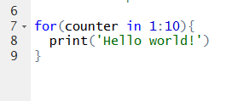
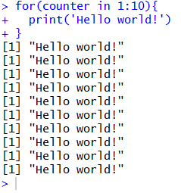
for loops

Slide 7
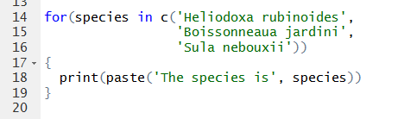
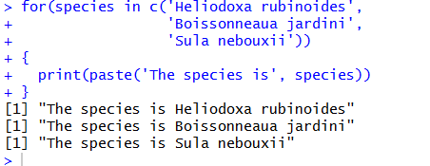
for loops

Slide 8
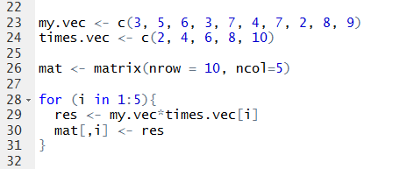
for loops
Use loops to fill in an empty matrix with results
E.g. multiply a vector by a series of numbers

Slide 9
BUT…
R does something most programming languages don’t do…
May not need to use loops at all!
VECTORIZATION

Slide 10
Apply family
Structured blob of data want to perform operations on
apply
tapply - table
lapply - list
sapply - simplify
mapply - multivariate

Slide 11
apply()
apply(data , MARGIN, FUN)
MARGIN = row and/or column
FUN = function to apply

Slide 12
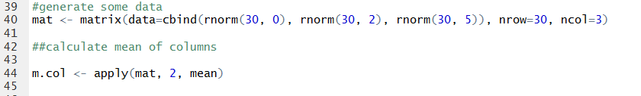
apply()
Use inbuilt function
Write own function

Slide 13
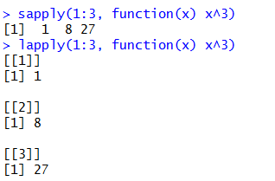
lapply() and sapply()
lapply() returns list
sapply() returns in simplest form

Slide 14
aggregate()
replace observations with summary statistics based on those observations
aggregate(x, by, FUN)
by must ALWAYS be a list
e.g. using mtcars

Slide 15
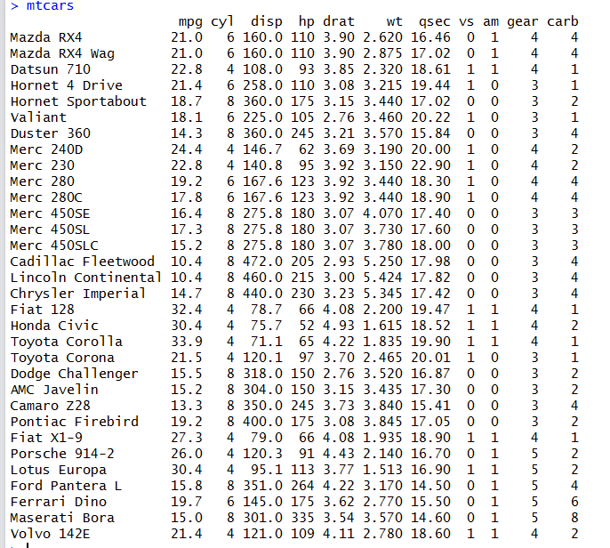

Slide 16
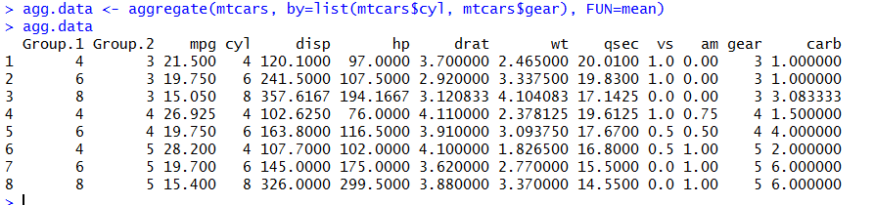
aggregate()
e.g. cars with 4 cylinders and 3 gears have on average 21.5 mpg

Slide 17
Summary
for loops are slow - avoid at all costs
apply family and aggregate are much nicer
can use own functions
can apply across multiple columns
by must be a list in aggregate even if only using one variable

Slide 18
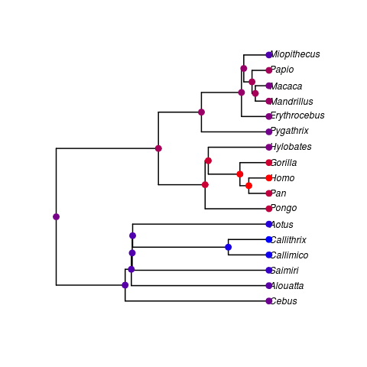
Next week
Guess who's back… for 1 week only…
Phylogenetics
ROOM 126 (own laptop)

